Slide 1
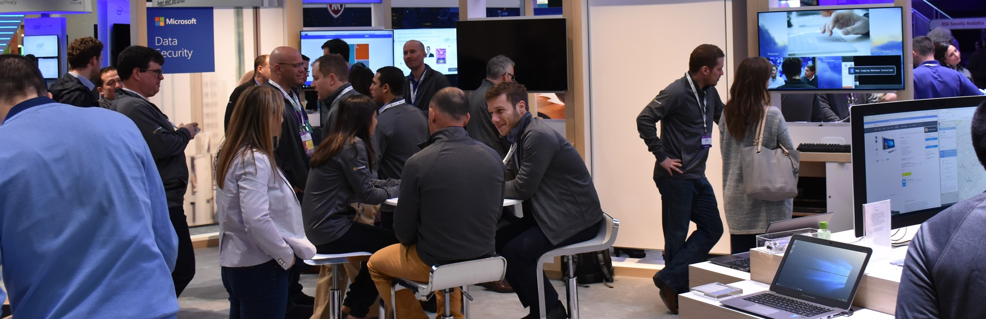
Node.js Interactive
Vancouver, BC Canada
Vancouver Convention Centre
October 4—6

Slide 2
Event Overview
What | Where | When
Audience
Vancouver Convention Centre
October 4-6
Demographics
Competitive Presence
Node.js Interactive is the marquee event for Node.js developers, companies that rely on Node.js and the vendors that support both of these constituents with tools, training and other services.
800 attendees
60% Software devs
94% attendees from US
11% attendees were women
Competitors: IBM, Google (GCP), Joyent, Heroku, Digital Ocean, Alibaba Cloud
Partners: nearForm, Node Source
Microsoft history
Key Discussion Topics
Past Microsoft Involvement
FY17 Learnings
Node.js development, ranging from front-end to back-end, from security to ops.
Platinum sponsors (with Google Cloud and IBM)
724 attendees
11% attendees completed conference survey (67% said main reason to attend was for technical training)
Notes:
Don’t choose too many metrics, make sure you are realistic about what you can track and measure

Slide 3
Event Blueprint
Dates | Location
Goals
Metrics
Messaging
Improve perception of Microsoft’s offerings for OSS developers
75%+ of respondents are more motivated to recommend/use Microsoft’s data offerings
Event Theme: Node.js end-to-end.
Microsoft provides Node.js developers and architects the tools and services they need to build, deploy, scale and monitor Node.js apps and services.
Visual Studio Code is the best code editor for Node.js developers, and TypeScript makes JS developers more productive
Developers and architects can leverage Azure to deploy and scale Node.js apps and services using IaaS, PaaS, CaaS and FaaS. Key services include Web Apps on Linux, Functions, Container Services.
Azure provides the tools needed to monitor apps and services in production too.
Key Messages
Acquire new leads for the GEP
250 unique leads scanned at the booth and in our sessions
Drive usage
Quality and engagement via demos.
CTAs
Visual Studio Code installs
Azure new trials
Contribute to Microsoft open source projects
Recommend/endorse Microsoft to others within open source community
Activities
Sessions
Expo Activities
Other Activities
Sponsored Session with Chris Dias (topic TBC)
IoT workshop with Jeremy Foster
Sessions by Arunesh Chandra (N-API, co-presenting with IBM), Bryan Hughes (Node.js projects), Chris Anderson (Functions)
8x10 booth
Booth demos
Booth survey
Team dinner/drinks for those who arrive on Tuesday, Oct 3! Please contact Alessandro for more details!

Slide 4
Roles and Responsibilities
Workstream | Core deliverables | Owner
Event Blueprint | Define objectives, success metrics, audience targeting, and key event activities | Alessandro Segala, PJ Meyer
Messaging & Merchandising Strategy | Development of key messages, primary CTAs & overall technology story featured at the event | Alessandro Segala, PJ Meyer
Measurement | Enable measurement of identified success metrics and goals on-site | Alessandro Segala, PJ Meyer
Keynote(s) | Development of keynote proposals, story line, content and content reviews
Session(s) | Development of paid and earned session/speaker proposals, session content and session reviews | Guarav Seth
Booth Production, Collateral, & On-Site Signage | Development of booth look and feel, branding, booth experience and collateral strategy. Also responsible for booth shipping, ordering show services and overall booth production | Claudia Brodeur
Demos Production, Demo Training & Booth Staffing | Development of demos, demo training and documentation. Also responsible for identifying the right demo staff and securing their commitment to support the event | Alessandro Segala, PJ Meyer
PR/AR | Development and implementation of the PR/AR plan for the event | Molly Coleman
Digital and Social | Development and implementation of the digital and social plan for the event | Gabriel Dorta
Field/Customer Engagement | Notifying local field office of presence at the event and any co-coordination of ancillary activities. (e.g. customer dinner, side meetings, boot camps, local hackathons, Immersions etc.)
Post Event Email & Nurture | Craft post event email and identify the appropriate GEP nurture stream for lead handoff | Alessandro Segala, PJ Meyer

Slide 5
Upcoming Deadlines
Deliverable | Status |  | Owner | Due Date
Floorplan Location | ✓ | Complete – 8/4 | Claudia Brodeur | August 11
Confirm Booth Structure | ✓ | Complete – 8/21 | Claudia Brodeur | August 15
Booth Graphics | ✓ | Complete – 8/29 | Claudia Brodeur | August 25
Breakout Session Content | ▲ | In Progress | Guarav Seth | September 1
Demos | ✓ | Complete | Alessandro, PJ | October 1
Staff Registration | ✓ | Complete | Alessandro, PJ | September 18
Hotels | ▲ | In Progress | Individual | September 9
Are you Hiring? | ▲ | In Progress | All | Email Cassandra
Swag (T-Shirts) | ▲ | In Progress | Alessandro, PJ
Swag (Stickers) | ✓ | Complete | Alessandro, Pablo
✓ Complete ▲In Progress ■To Do

Slide 6
Event Schedule
Set Up/Break Down
SET UP (OCT 3) | 3:00PM – 6:00PM
BREAK DOWN (OCT 5) | 4:30PM – 10:00PM
Day 1 Wednesday, October 4
BREAKFAST | 7:30AM – 9:30AM
OPENING KEYNOTE | 9:00AM – 10:30AM
MAGGIE PINT (KEYNOTE) | 10:00AM – 10:30AM
EXPO HALL OPEN | 10:30AM – 7:30PM
BREAKOUT SESSIONS | 11:00AM – 12:35PM
JEREMY FOSTER WORKSHOP | 11:00AM – 12:50PM
CHRIS DIAS SPONSOR SESSION | 11:40AM – 12:10PM
LUNCH | 12:35PM – 2:05PM
BREAKOUT SESSIONS | 2:50PM – 5:50PM
ARUNESH CHANDRA SESSION | 3:00PM – 3:30PM
BRYAN HUGHES SESSION | 3:40PM – 4:10PM
BOOTH CRAWL | 5:30PM – 7:00PM
OFFISITE EVENING EVENT | 7:15PM – 10:00PM
Day 2 Thursday, October 5
BREAKFAST | 7:30AM – 9:00AM
BREAKOUT SESSIONS | 9:00AM – 12:05PM
EXPO HALL OPEN | 10:00AM – 4:30PM
CHRIS ANDERSON SESSION | 10:40AM – 11:10AM
LUNCH | 12:05PM – 1:35PM
BREAKOUT SESSIONS | 1:35PM – 3:45PM
BOWDEN KELLY SESSION | 2:40PM – 3:10PM
CLOSING KEYNOTE | 4:15PM – 5:45PM
RACHEL WHITE (KEYNOTE) | 5:20PM – 5:40PM
Friday, October 6
9:00AM – 12:00PM
Code & Learn – Get started (or go further) with Node.js core contributions. Experienced contributors help guide you through your first (or second or third or fourth) commit to Node.js core. They also are available to provide impromptu guided tours through specific areas of Node.js core source code.
1:00PM – 5:00PM
Collaboration Summit - Collaboration Summit is an un-conference for contributors to Node.js to get together and discuss Node.js. Various Working groups will be represented. More information will be provided as the event agenda is finalized.

Slide 7
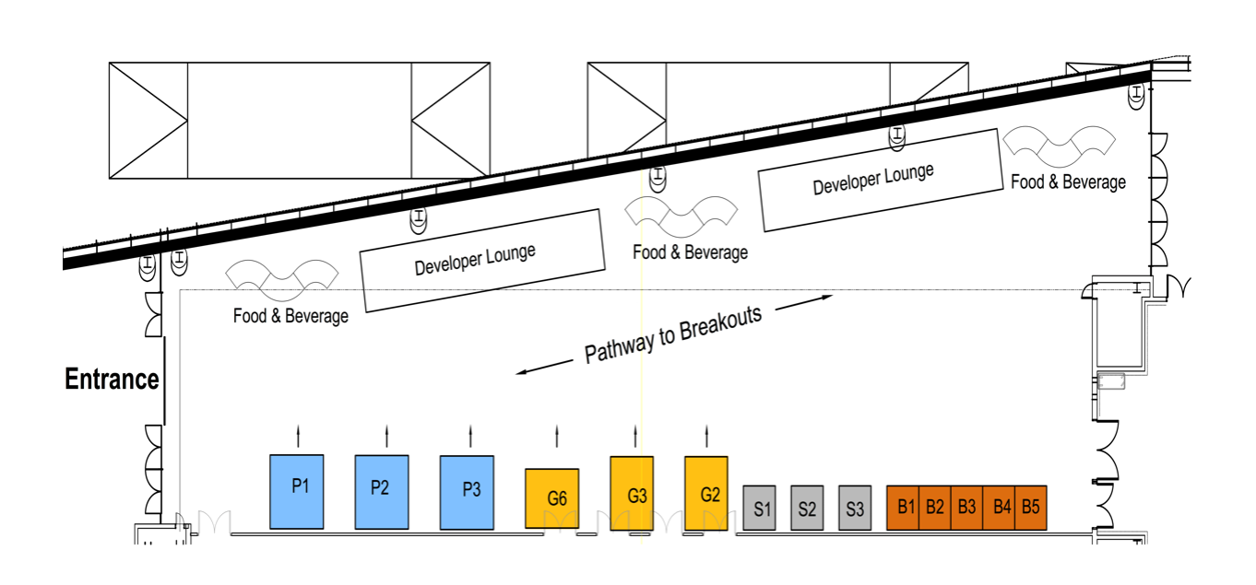
Expo Hall
SUMMARY
Microsoft is located at G2 | Booth is 8’x10’ turnkey
Microsoft Booth
Notes:
One (1) Fabric Graphic Backwall 2m wide x 2.5m high
One (1) Counter 0.75m wide x 0.75m deep x 1m high with front panel graphic
Counter rear access storage cabinet with sliding door and front face graphic
Two (2) stools
(1) 10 amp power drop with power strip
Event Wifi access
60” on a rolling stand

Slide 8
Expo Hall
SUMMARY
Microsoft is located at G2 | Booth is 8’x10’ turnkey
Plus monitor from Vancouver office for demos
Notes:
I'm consolidating the floorplan and looking to move some spaces around. The traffic will be going from left to right as the entrance doors are where people will come in from registration and the keynote, but the doors on the upper right are the access to the breakout rooms so people will be walking back and forth that way - I think this would be much higher traffic for you.
Also, the space the says Developer Lounge will be an area with lounge seating where people can sit and work or chat. That would be right across from G4.
I'm also moving the f&b, all day coffee and breaks to be right behind G4 - that is the reason we have the booths oriented left to right, so you can access traffic from both the breakout traffic, but also the traffic as people pass by to access the food.
Here's a screenshot of the proposed new layout for the front of the hall - apologies it's in black, that's my drafting software.
I'm happy to keep you in G2 if that's your preference, I just wanted to give you the opportunity to move up as I do think you will have better visibility and traffic.

Slide 9
Content
SUMMARY
WORKSHOP
1 SPONSOR SESSION
Chris Dias
1 EARNED WORKSHOP
Jeremy Foster – A Complete IoT Worship (B)
3 EARNED BREAKOUT SESSIONS
Arunesh Chandra & Michael Dawson (IBM) - N-API – Next Generation Node API for Native Modules (I)
Bryan Hughes - Getting Involved in the Node.js Project
Christopher Anderson - The Future is Serverless: What That Means for Node.js
1 EARNED KEYNOTE
Rachel White – The Creative Side of Node.js
TITLE
A Complete IoT Workshop (B)
ABSTRACT
Time to learn some full spectrum IoT solution development! In this hands on workshop, you'll work in a small group to hook a Raspberry Pi 3 and a simple electronic circuit and then write the code to send data to Azure IoT. We'll read a camera, flash lights, push buttons, and learn a lot! If you like hacking on hardware and software, or if you have never done this but want to try, this workshop is for you. In this workshop you will learn things like: • Getting a Raspberry Pi up and running to code using Node.js • Deploying code to your RP wirelessly • Wiring up a basic electronic circuit on a breadboard • Using the GPIO pins to read a button and flash an LED • Capturing images from a camera and analyzing then using Microsoft Cognitive Services • Sending data to Azure IoT Hub
Speaker: Jeremy Foster
Date: Wednesday, October 4
Start Time: 11:00AM
End Time: 12:50PM
Room: West Meeting Room 117

Slide 10
Content
KEYNOTE SESSION
KEYNOTE SESSION
TITLE
JS Foundation Panel: The Many Facets of Sustaining an Open Source Ecosystem
ABSTRACT
TITLE
The Creative Side of Node.js
ABSTRACT
Speaker Photo
Speaker: Maggie Pint
Date: Wednesday, October 4
Start Time: 10:00AM
End Time: 10:30AM
Room: West Ballroom A
Speaker: Rachel White
Date: Thursday, October 5
Start Time: 5:20PM
End Time: 5:40PM
Room: West Ballroom A

Slide 11
Content
SPONSOR SESSION
BREAKOUT SESSION
TITLE
VS Code: Optimize your Node.js Development "Inner Loop"
ABSTRACT
VS Code...Maybe you've heard about it, or you've seen your friends using it. Maybe you've tried it once or twice, or maybe you use it every single day. No matter what camp you fall into, in this session you'll learn something new about using VS Code and how to quickly build and deploy node.js applications and micro-services.
We'll configure VS Code for the "inner loop" of development - the edit, compile, debug cycle. See how VS Code provides great code editing and code navigation experiences such as semantic IntelliSense, GoTo Definition, Find All References, Linting (e.g. ESLint), and more. We will configure VS Code to enable single file debugging, gulp file debugging, mocha debugging, and both client and server side debugging in a single session. You will see how easy it is to create Docker artifacts with VS Code, how to build and deploy images, and even how to debug your node.js applications running in containers.
how easy it is to create Docker artifacts with VS Code, how to build and deploy images, and even how to debug your node.js applications running in containers.
TITLE
N-API – Next Generation Node API for Native Modules (I)
ABSTRACT
Until now, native module (add-ons) maintainers have had to recompile for each Node.js release as well as potentially updating their code to cope with the rapid pace of changes in the v8 APIs. The community API working group has been developing the N-API (Node-API) as a follow on to Nan to help solve this problem and insulate modules from changes in the v8 APIs. By targeting the new API, modules will be able support a wide variety of Node.js releases without needing recompilation or abstraction layers such as Nan - reducing deployment time and maintenance effort for both module developers and Node.js end users. With an initial version of the API slated to be part of Node version 8 as an experimental feature, it is a good time to come learn about the shape and usage of the new API from those working to implement it.
Speaker Photo
Speaker: Chris Dias
Date: Wednesday, October 4
Start Time: 11:40AM
End Time: 12:10PM
Room: West Ballroom A
Speaker Photo
Speaker: Arunesh Chandra & Michael Dawson (IBM)
Date: Wednesday, October 4
Start Time: 3:00PM
End Time: 3:30PM
Room: West Meeting Room 120

Slide 12
Content
BREAKOUT SESSION
BREAKOUT SESSION
TITLE
Getting Involved in the Node.js Project
ABSTRACT
Open source projects don't succeed on good code alone, they succeed because of a healthy and growing community. Over a thousand people have contributed to Node.js, and we're adding new contributors all the time. The Node project is not one to rest on its laurels though. We have plans to make it easier for a larger, more diverse group of people to participate to the project. Come hear the history of the Node.js project and why increasing participation has led to a better platform. Learn how the project makes it easy to contribute, and how we plan to make it even easier. Join us on our journey in creating a truly amazing platform!
TITLE
The Future is Serverless: What That Means for Node.js
ABSTRACT
Serverless computing is sweeping the cloud industry and transforming how we're building applications on the cloud. Node.js has been the first language each of the major serverless providers has supported from day 1. Node.js applications written for serverless are changing from their "server"ed past. We'll discuss why serverless went Node.js first, what impact this will have on Node.js developers, and finally, what consequences this might have on Node.js's ecosystem.
Speaker Photo
Speaker: Bryan Hughes
Date: Wednesday, October 4
Start Time: 3:40PM
End Time: 4:10PM
Room: West Meeting Room 120
Speaker Photo
Speaker: Christopher Anderson
Date: Thursday, October 5
Start Time: 10:40AM
End Time: 11:10AM
Room: West Meeting Room 120

Slide 13
Content
BREAKOUT SESSION
TITLE
TypeScript – A Love Tale with JavaScript
ABSTRACT
Around 5 years ago, we embarked on a journey to create TypeScript. It all began with our love and passion to help JavaScript developers create applications that scale. TypeScript has come a long way since then. This session will dive head first on a demo driven tour of what Typescript is and the value it brings for JavaScript developers. You'll walk away knowing how to quickly add TypeScript to your own apps, see some of the latest features in action and most importantly, get a first-hand experience of the productivity gains it brings to your JavaScript apps.
Speaker Photo
Speaker: Bowden Kelly
Date: Thursday, October 5
Start Time: 2:40PM
End Time: 3:10PM
Room: West Ballroom A

Slide 14
Demo Stations
Demo Station Header
Demo Station Owner
Demo Station Header
Demo Station Owner
Key Message:
Talking Points
Add text
Add text
Add text
Demos/Decks to be Used
Add text
Add text
Add text
Key Message:
Talking Points
Add text
Add text
Add text
Demos/Decks to be Used
Add text
Add text
Add text

Slide 15
Staff Scheduling
Wednesday, October 4 | 10:00AM – 12:00PM | 12:00PM – 2:00PM | 2:00PM – 4:00PM | 4:00PM – 6:00PM | 6:00PM – 7:30PM
Booth Staff | Matt Hernandez | Yosef Durr | Jef King | Tom Archer | Gaurav Seth
Booth Staff | Anthony Chu | Brian Clark | Mike Kaufman | Matt Hernandez | Anthony Chu
Booth Staff | Tommy Lewis | Hitesh Kanwathirtha | Nastassia Rashid | Hitesh Kanwathirtha | Jef King
Speaker Presence (post session) | Maggie Pint | Jeremy Foster, Chris Dias | Arunesh Chandra | Bryan Hughes | -
Booth Manager | Claudia Brodeur | Alessandro Segala | PJ Meyer | Alessandro Segala | Claudia Brodeur
Thursday, October 5 | 10:00AM – 12:00PM | 12:00PM – 2:00PM | 2:00PM – 4:00PM
Booth Staff | Tommy Lewis | Yosef Durr | Brian Clark
Booth Staff | Mike Kaufman | Nastassia Rashid | Tom Archer
Speaker Presence (post session) | Christopher Anderson | - | Bowden Kelly
Booth Manager | PJ Meyer | Alesasndro Segala | Claudia Brodeur

Slide 16
Staff & Pass Allocation
Name | Role | Reg | Notes
Alessandro Segala | Business Owner | Yes
PJ Meyer | Business Owner | Yes
Claudia Brodeur | Event Lead | Yes
Bryan Hughes | Speaker | Yes
Chris Anderson | Speaker | Yes
Arunesh Chandra | Speaker
Chris Dias | Speaker | Yes
Jeremy Foster | Speaker | Yes
Matt Hernandez | Booth Staff (Engineering)
Anthony Chu | Booth Staff (Dev Advocate) | Yes
Tom Archer (?) | Booth Staff (Engineering)
Gaurav Seth | Demo Lead (Engineering) | Yes
Brian Clark | Booth Staff (Dev Advocate) | Yes
Tommy Lewis | Booth Staff (Advocate CA) | Yes
Yosef Durr | Booth Staff (Engineering) | Yes
Nastassia Rashid | Booth Staff (Advocate CA) | Yes
Maggie Pint | Speaker (Engineering) |  | (Developer in Azure) just got added to the James Snell panel – she wanted to make sure marketing was informed.
Name | Role | Reg | Notes
Rami, Farhat | Attendee | Yes
Ian Hollier | Attendee | Yes
Hitesh Kanwathirtha | Booth Staff | Yes
Mike Kaufman | Booth Staff | Yes
Jef King | Booth Staff | Yes
Eric Lai | Attendee | Yes
Mark Marron | Attendee | Yes
Matthew Meyer | Attendee | Yes
Jeff Principe | Attendee | Yes
Douglas Richardson | Attendee | Yes
Osvaldo Rosado | Attendee | Yes
Tejbir Sodhan | Attendee | Yes
Vishwam Wubramanyam | Attendee | Yes
Kamil Szostak | Attendee | Yes
George Trifonov | Attendee | Yes
Kimberly Wolk | Attendee | Yes
Robin Ginn | Business Owner
Notes:
+ Rachel White (Keynote Speaker)
+ Robin Ginn

Slide 17
Staff Readiness & Logistics
THINGS TO REMEMBER
STAFF CHECKLIST
Educate the press but don’t generate any news yourself. Some of you at the event will be in a position where you will talk with the press. If you spend time with them please remember that if they ask any questions that you’re not an expert in you should not try to answer them—refer them to a member of the PR team. Remember, anything you say can be quoted
Help out if anyone needs help. We’re all in this together and there is lots of work to be done. Much of it is going to be outside what you would normally expect to be your scope of expertise or job description. If you have spare time, please volunteer or ask if people need help
Come Prepared. Know your staff assignment, know the demos, know our key messages. Keep our objectives and success metrics in mind. Your actions should bring us closer to meeting them
Have fun. We are an unexpected presence at this event, so we are earning respect. Be proud to be part of it, and enjoy the challenging conversations that are sure to come
Are you ready? Below is your checklist on how best to prepare:
Learn the demos
Understand our competition
Understand our event goals and messages
Familiarize yourself with the audience profile
Accept your S+’s for your booth assignments
Make sure you are registered for the event
Please remember to scan badges!
ATTIRE
MANDATORY STAFF MEETING
FORECAST
Business Casual + Microsoft Jacket
Comfortable but professional shoes

Slide 18
Event Recap
Dates | Location
KEY ACTIVITIES
Joseph Sirosh keynote
1 paid and 4 earned sessions
20x30 Booth + 10x10 HOL
VIP Customer dinner
Objectives | Goal | Actual | Status
Increase awareness/shift perception
MSFT Reach | 3,000 | 4,000
Session Attendance | 1,800 | 2,000
Motivation to recommend, try, or purchase MSFT | 70% | 75%
MSFT solution awareness | 70% | 76%
MSFT solution LTR | 70% | 75%
Key message pick up | 75% | 72%
Drive contactability/nurture
Leads delivered to Marketo | 800 | 400
Net new leads |  | 338
Field & pipeline enablement
Hi-Po Customer Dinner Attendees | 35 | 45
Customer Side Meetings | 15 | 16
KEY TAKEAWAYS
Hands-on lab booth was successful offering deeper learning for attendees
High demand for customer meeting room. Negotiated additional room in FY17
RECOMMENDATIONS
Continue to evangelize the call for content early to secure more sessions
Work with the US Sub earlier for important decisions regarding VIP Dinner & Customer Meetings
Continue to improve lead collection with booth staff. Work with event organizers to scan MSFT session attendees
Sessions | Rating | Attendees
Joseph Sirosh: Keynote | 4.47/5 | 1,397
Matt Winkler: Paid Session | 3.57/5 (avg) | 143
Met or exceeded target
Close to target
Missed target

Slide 19
Photos

Slide 20
Post Mortem
Post Mortem
 | What went well? | Opportunities for Improvement
Messaging & Merchandising (Was this the right GTM Strategy?)
Keynote
Sessions
Booth production, on-site signage, collateral, giveaways
Demo production, staffing, staff readiness

Slide 21
Post Mortem
 | What went well? | Opportunities for Improvement
Customer meetings
PR & AR
Social
Overall event presence

Slide 22
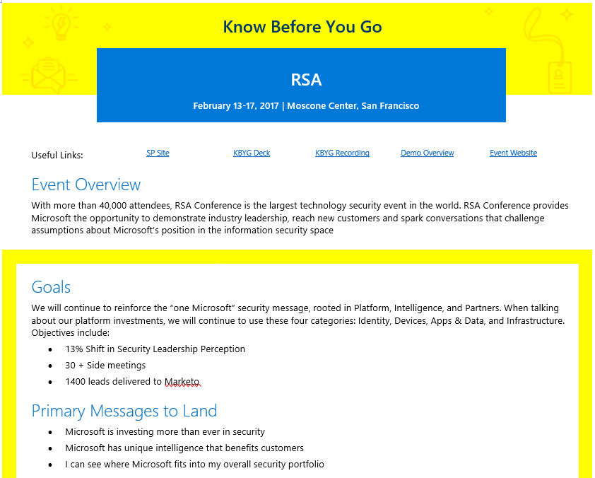
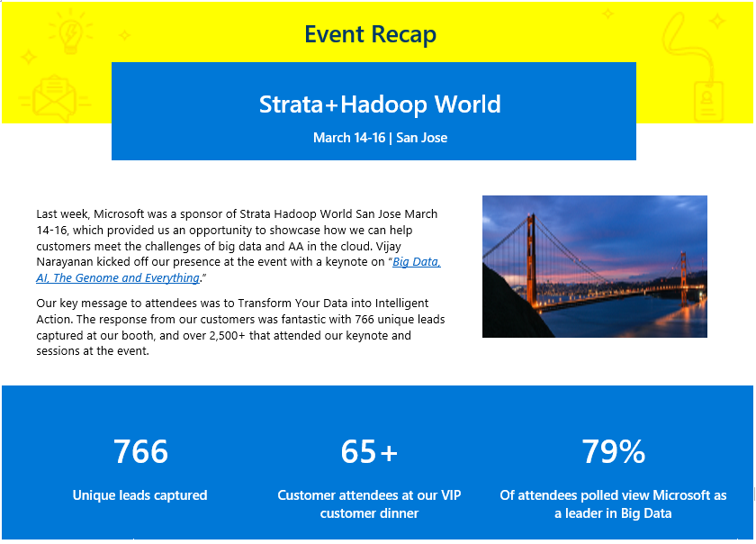
Know Before You Go & Post-Mortems
Know Before You Go Emails provide a snapshot into all the event activities of interest.
Post-Mortems provide a summary recap of highlights, key data points, challenges and learnings
Templates available here

Slide 23
Surveys
Surveys are a great way to measure perception change and awareness. They’re also a great way to learn more about attendees.
Microsoft-approved survey tools: Qualtrics, NetReflector, Instant.ly, SurveYou
With most of these tools, you can create a QR code and a short URL (at aka.ms) to make it easy for attendees
Standardized questions we ask across all events
How strongly would you agree that your engagement with us at <event> has motivated you to either recommend, try, purchase, or deploy Microsoft products and/or services?
How has your <knowledge/ awareness> of <MSFT solution> changed as a result of your engagement with us at <event>?
How likely are you to recommend <MSFT solution> as a result of your engagement with us at <event>?
How has your perception that <key message> changed as a result of your engagement with us at <event>?
Strongly Agree, Somewhat Agree, Neutral, Somewhat Disagree, Strongly Disagree
My <knowledge/awareness> has improved a lot, has improved a little, has not improved at all
Definitely will recommend, Probably will recommend, May or may not recommend, Probably will not recommend, Definitely will not recommend
My perception is more favorable, My perception is unchanged, My perception is less favorable

